Slide 1

Stock prediction using Machine Learning
By:
Siddharth Desai

Slide 2
Introduction
Financial markets are highly volatile and generate huge amounts of data daily
Stocks are the most popular financial market instrument and its value changes quickly
Stock prices are predicted to determine the future value of companies’ value or other financial instruments that are marketed on financial exchanges
However, the stock market is influenced by many factors such as political events, economic conditions and traders’ expectation

Slide 3
Abstract
Time series forecasting has been widely used to determine the future prices of stock, and the analysis and modelling of finance time series importantly guide investors’ decisions and trades
This work proposes an intelligent time series prediction system that uses machine learning for the purpose of predicting the stock prices
The code can be used for any Timeseries having required data
The proposed model is a promising predictive technique for highly non-linear time series, whose patterns are difficult to capture by traditional models.

Slide 4
Machine Learning in Stock Prediction
The field of Machine Learning is vast and plays a key role in a wide range of critical applications.
Predicting the stock market involves predicting the closing prices of a company’s stock for any given number of days ahead.
Machine Learning can be used to perform Linear Regression on previous stock data to predict the closing prices using Time series forecasting and other optimization algorithms
In Stock Prediction we require various variables as input which can be used by our code for learning

Slide 5
Overview of the Project
The Company used for original code is Tata
The Company used for Updated code is Apple Inc
All the prices mentioned here are in lacs for original code and Dollars for updated code
The original code uses 3 variables for its calculation i.e. Open value, Volatility and Turnover
The updated code will be using Adjusted close, Volume

Slide 6
Process
Datasets are collected from Kaggle
01
The data from datasets is then used to train the system
02
Trained model are prepared using the code which includes input variables
03
Using the model, closing prices are predicted
04

Slide 7
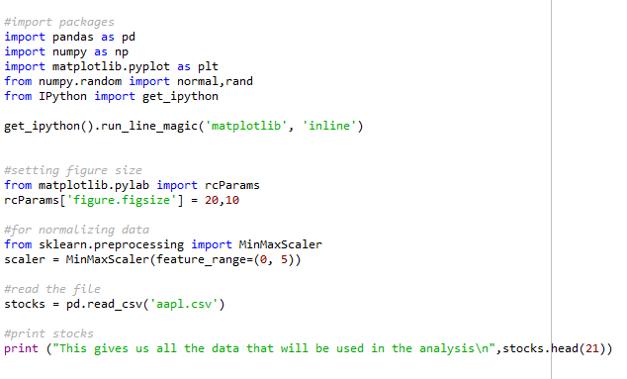
Code
I am using standard libraries such as Pandas and NumPy
For numerical functions I am using Matplotlib

Slide 8
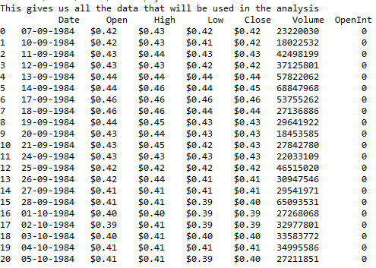
Result

Slide 9
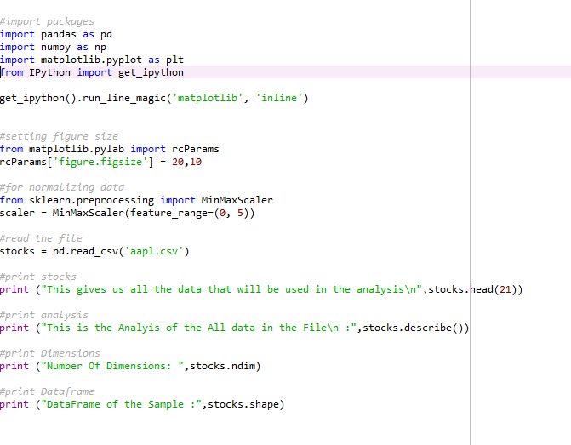
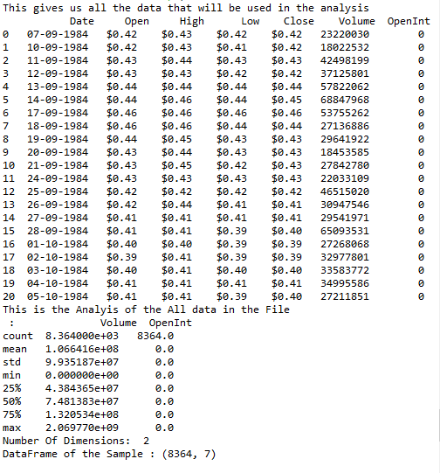
Analysis, Dimensions and Dataframe

Slide 10
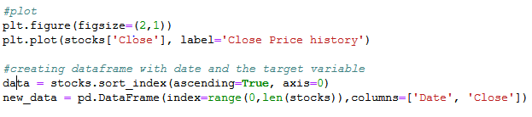
Plotting Close Price

Slide 11
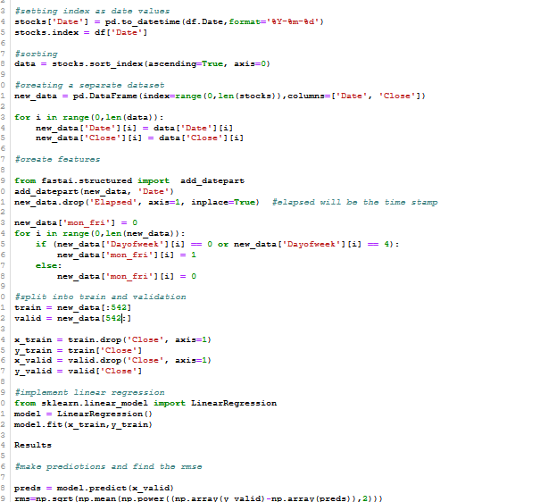
Linear Regression

Slide 12
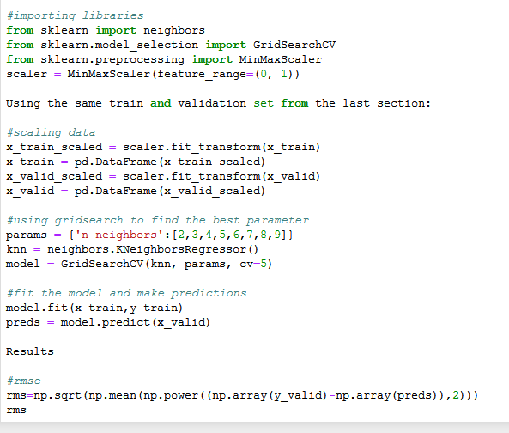
K-Nearest Neighbours

Slide 13
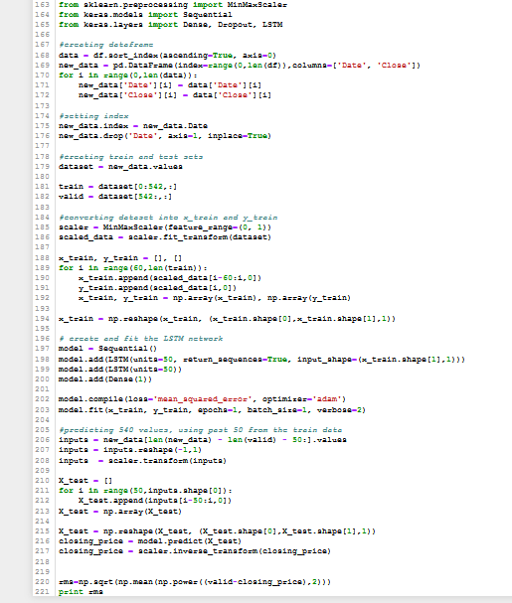
Long Short Term Memory

Slide 14
Conclusion
Thus, as we can see above in our proposed method, we train the data using existing stock dataset that is available. We use this data to predict and forecast the stock price of n-days into the future.
The average performance of the model decreases with increase in number of days, due to unpredictable changes in trend.
The current system can update its training set as each day passes so as to detect newer trends and behave like an online-learning system that predicts stock in real-time

Slide 15

Thank You

